Slide 1
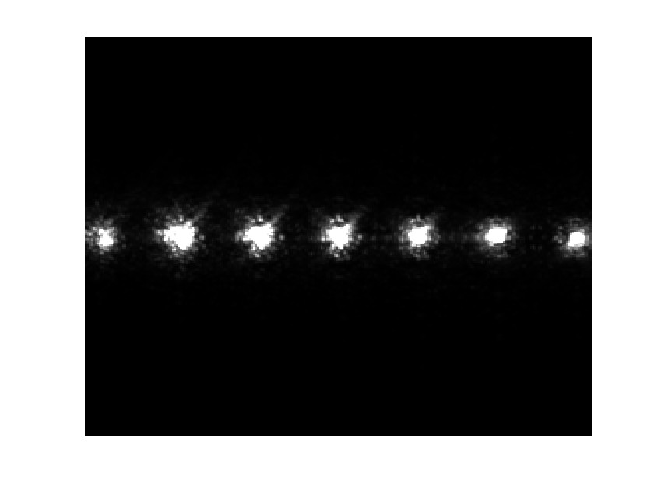
k-space
F0
F1
F2
F3
F4
F5
F6
40 lines
FOV 256×256
Notes:
The F-states are shifted apart in the k-space using a 40 lines shift spoiler gradient.

